Slide 1


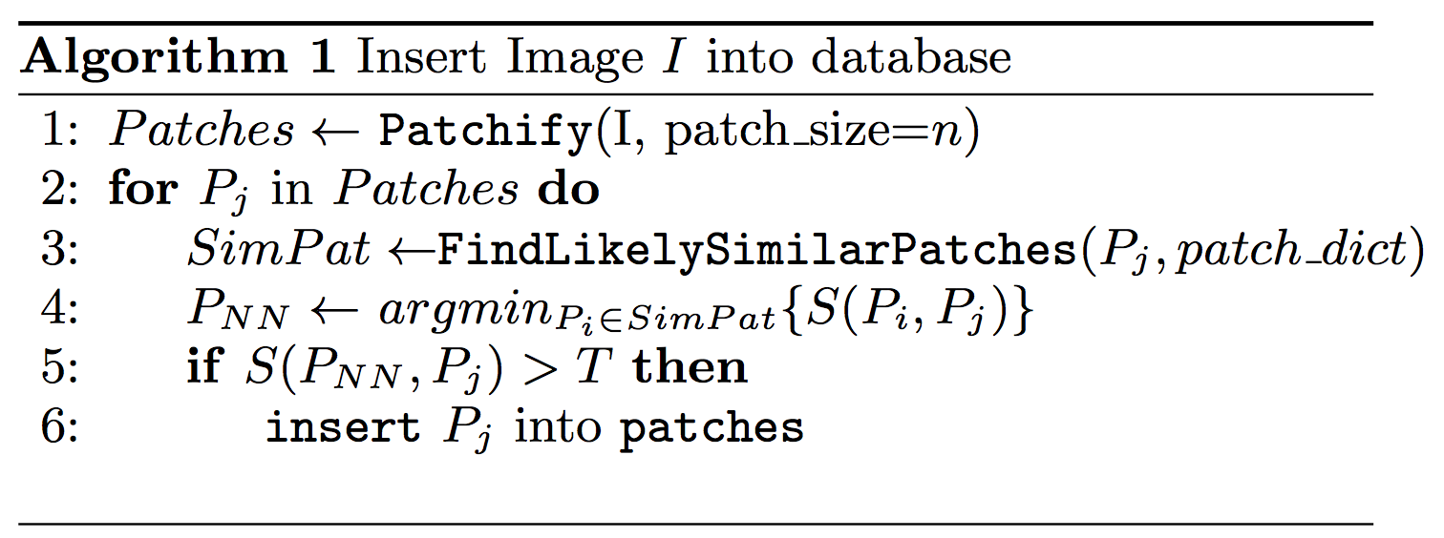
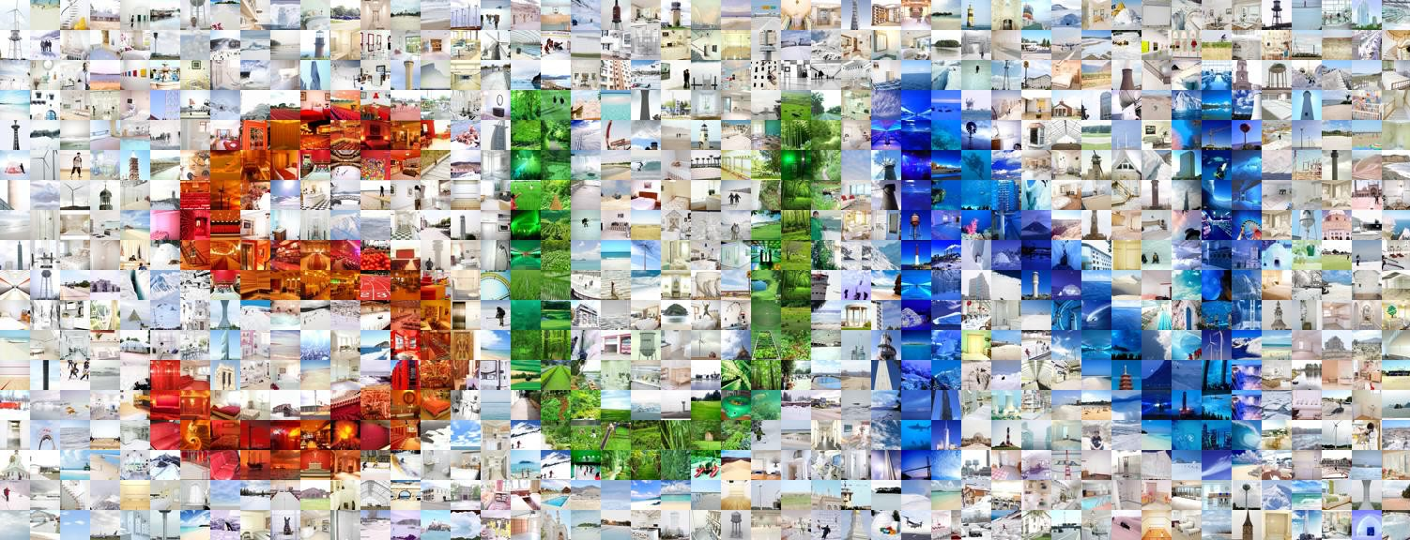
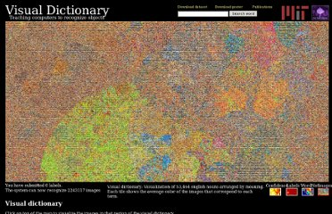
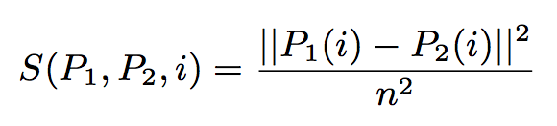
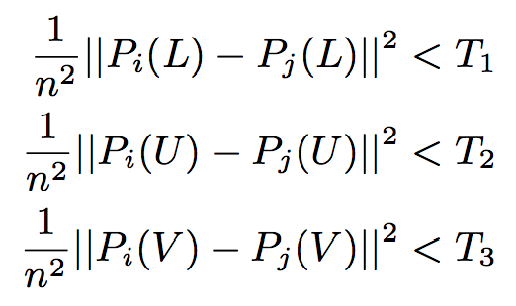
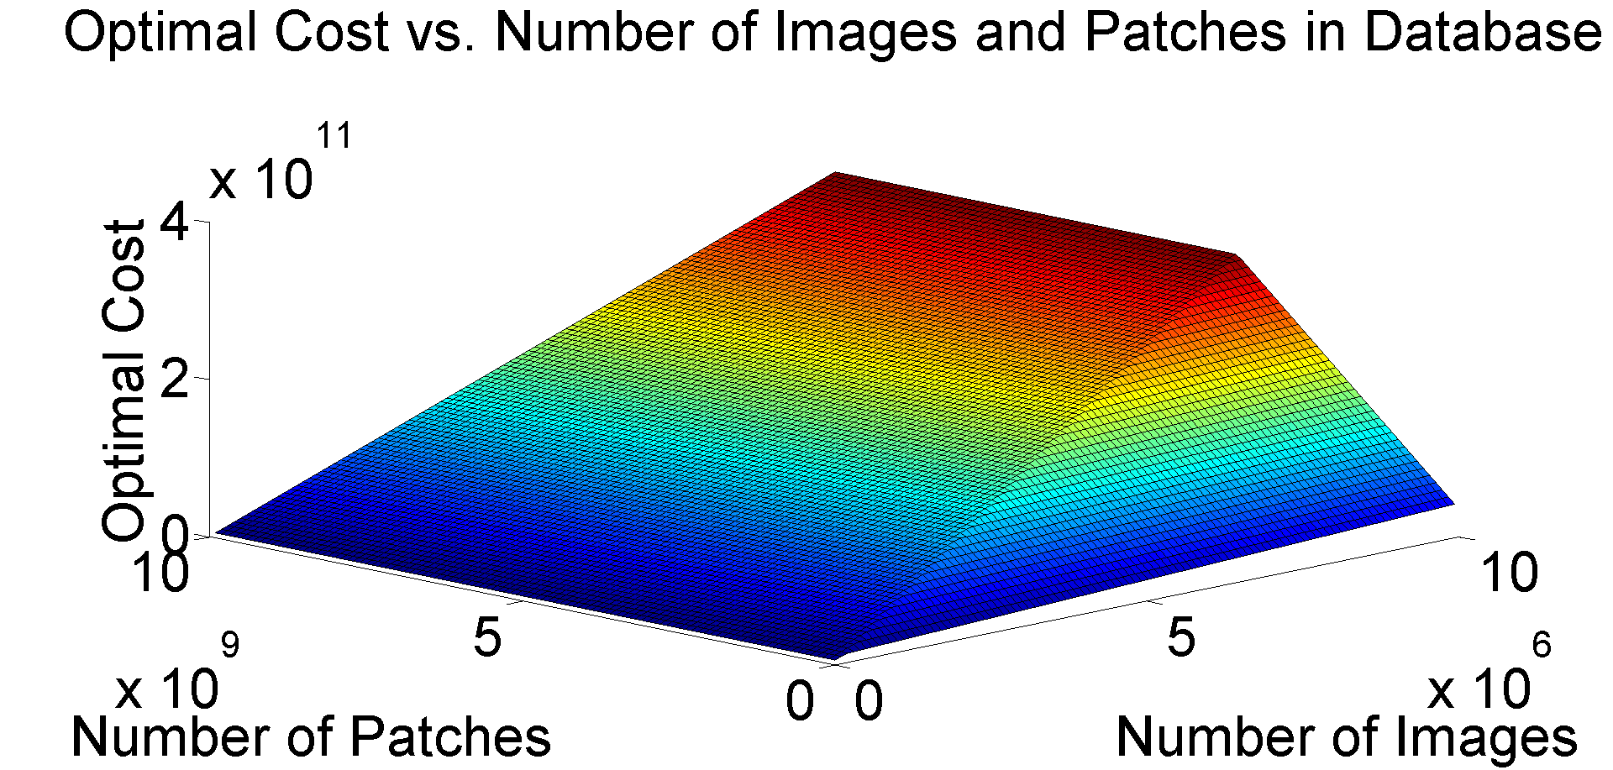
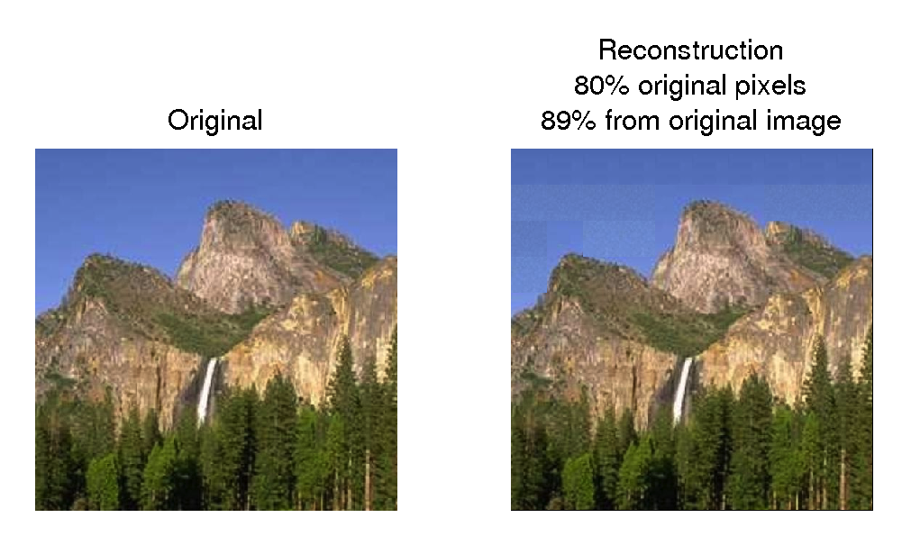
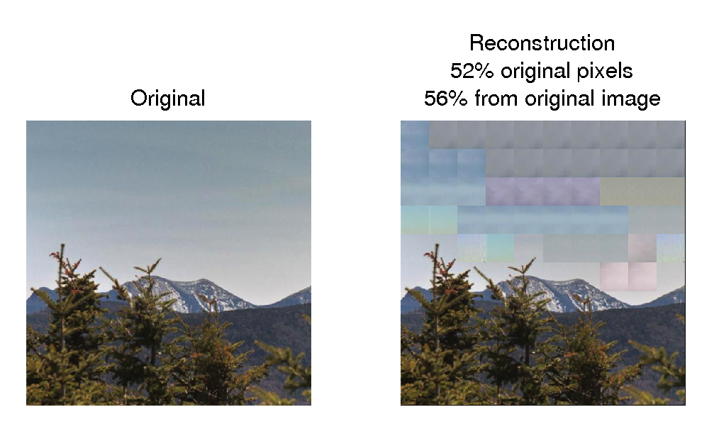
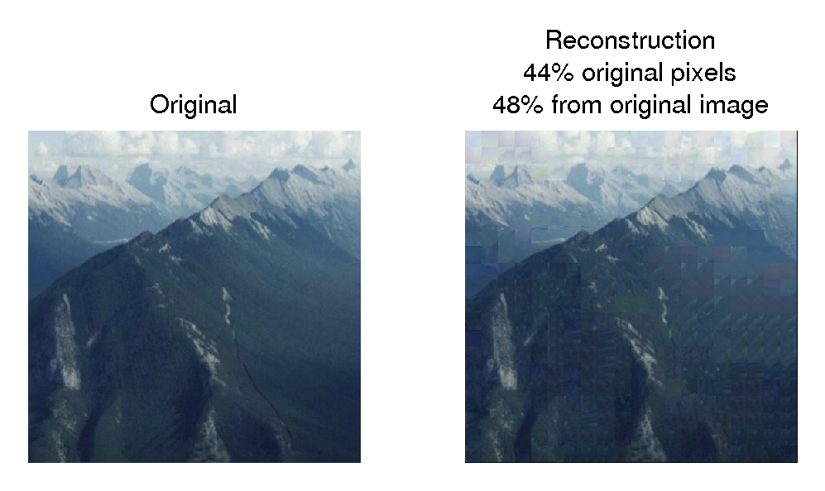
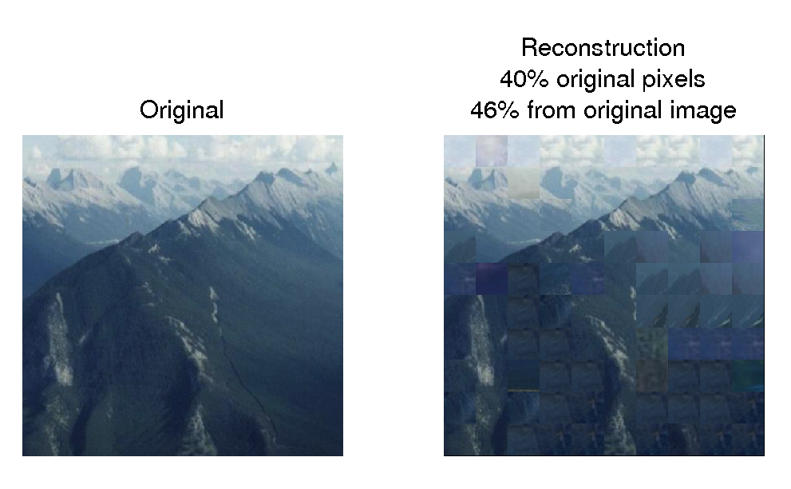
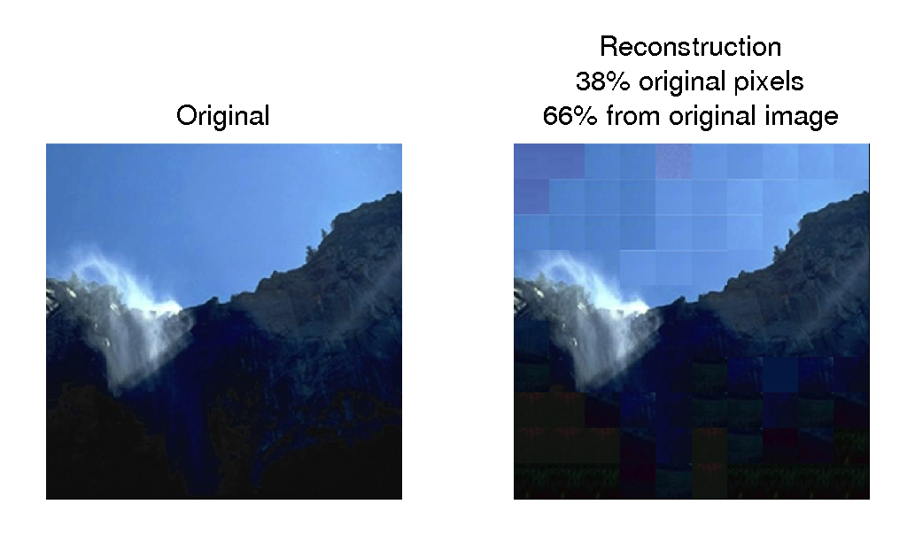
Rasterized Image Databases for Image Compression
6.830
Database Systems
Final Project
Zoya Bylinskii*, Maria Shugrina*, Andrew Spielberg*, Wei Zhao*
MOTIVATION
APPROACH
RESULTS
More than 1.8 billion images uploaded to the internet every day
Redundancy in large image collections can lead to more efficient storage
Let image size be nxn, patch size be mxm, # of images = k
Generalizability across image types:
PATCH-BASED IMAGE CODING
Computing distance per color channel:
Lossy compression
Compression savings INCREASE as the database size INCREASES
Rasterization is a simple operation – easily deconstruct and reconstruct images using patches
CIE (LUV) color space
Threshold per color channel:
within-image
(e.g. JPEG)
across-image
(our approach)
Compression
Big Data
Big Data
APPLICATIONS
EXTENSIONS
duplicate detection
similar image retrieval
context-aware patch sampling
task-aware threshold selection
patch hierarchies
DATABASE SCHEMA
int ID
int ID
images
patch_pointers
patch_dict
int img_ID
int patch_ID
[int,int] LOC
bytea PATCH
PARAMETER SELECTION
Weighting storage savings and reconstruction speed against compression quality:
A number of factors, including the patch size, distance function, and threshold affect the costs of the patch-based compression scheme.
The importance of the right patch sampling technique:
The importance of the right color space and a threshold per color channel:
The importance of the right patch size:
The importance of the right distance function and threshold:

